Slide 1
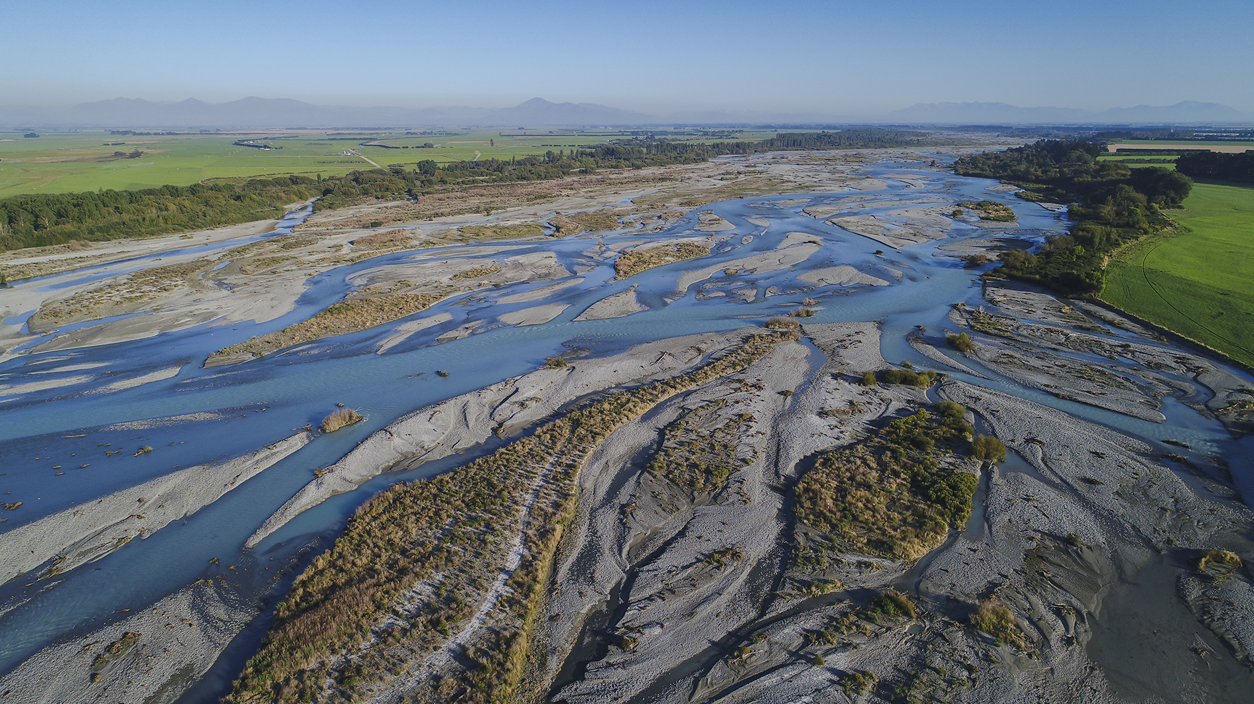
Environment Canterbury NE Ashburton On-Site Wastewater consents
Rangitata River, Canterbury

Slide 2
Current Situation
Smaller lot sizes and changing land use has resulted in increased need for wastewater systems.
High number of drinking water wells and waste water systems.
Cumulative effects of more housing and more consent applications raises concerns regarding E.coli and Nitrate.
This area has been identified through ongoing testing as having high levels of nitrates in its water.
Auditing of applications has been slow due to these factors – causing frustration and delay for community members
Notes:
CS
Following the re-zoning of land in north east Ashburton, a number of the community have subdivided land or purchased sections in this area.
An increasing number of the community have applied (or are preparing to apply) for on-site wastewater consents in this area for these sections.
National and regional legislation has been introduced that increases the focus on safe drinking water and improving quality where degraded.
This area also has a combination of historical factors based on rules at the time and other environmental factors.

Slide 3
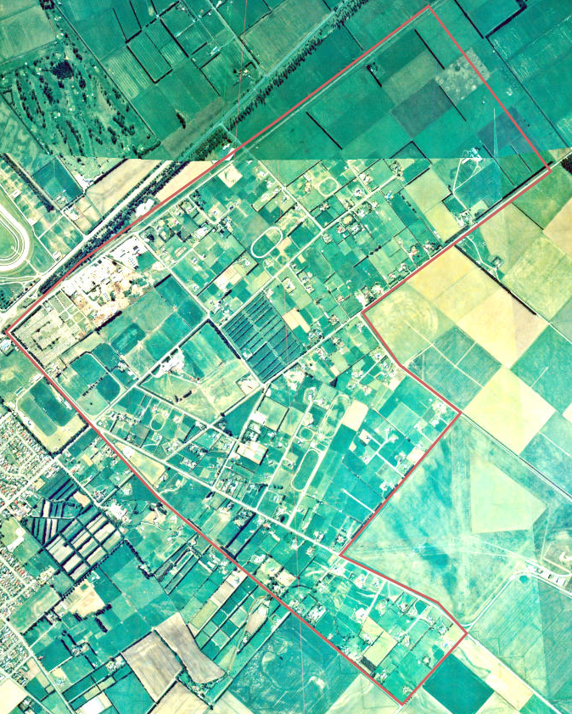
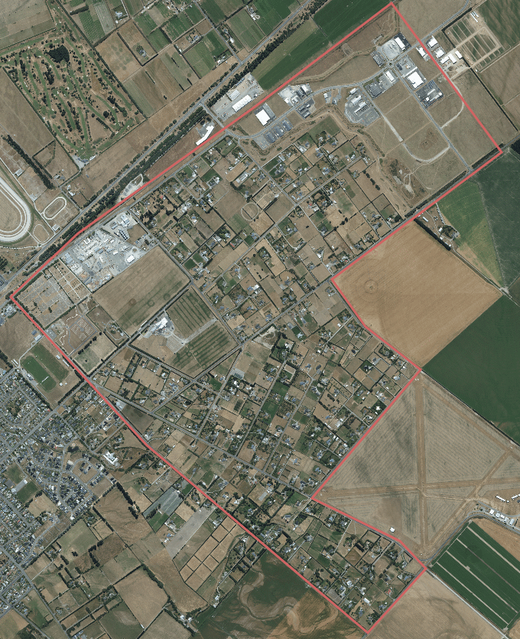
Changing land use – mid 1990s-mid 2010s
Notes:
CS

Slide 4
Where are we talking about?
Notes:
CS

Slide 5
Consenting pattern
We have consented on-site wastewater systems in this area in the past.
Since the re-zoning of this area to residential there has been an increase in on-site wastewater applications (both subdivisions and individual lots).
As a result of this there is concern about the cumulative effects of increasing intensification on water quality and its potential impacts on health.
Based on nitrate levels in water testing in the area risk of proceeding in the same way raises community health and environmental quality risks.
Notes:
Aurora
Every consent considered on its individual merits, Larger lot sizes in the past, different rule framework

Slide 6
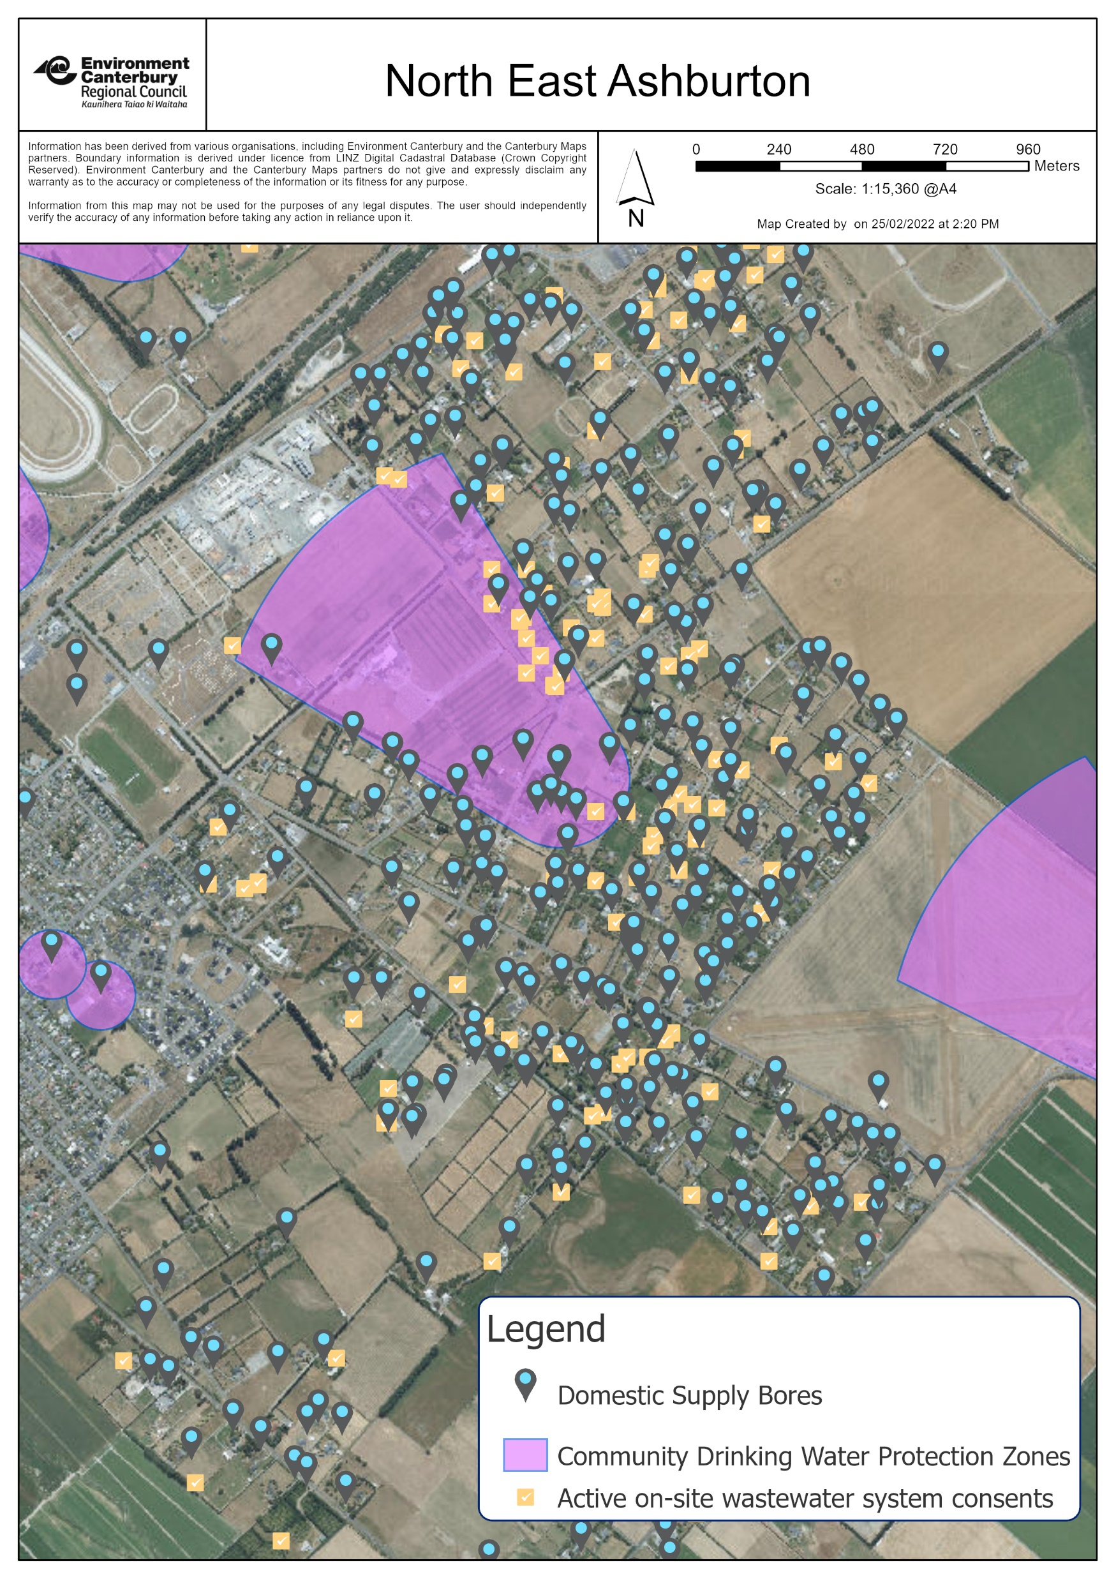
Notes:
AG
Map showing addresses, lot sizes and number of dwellings for consent applications

Slide 7
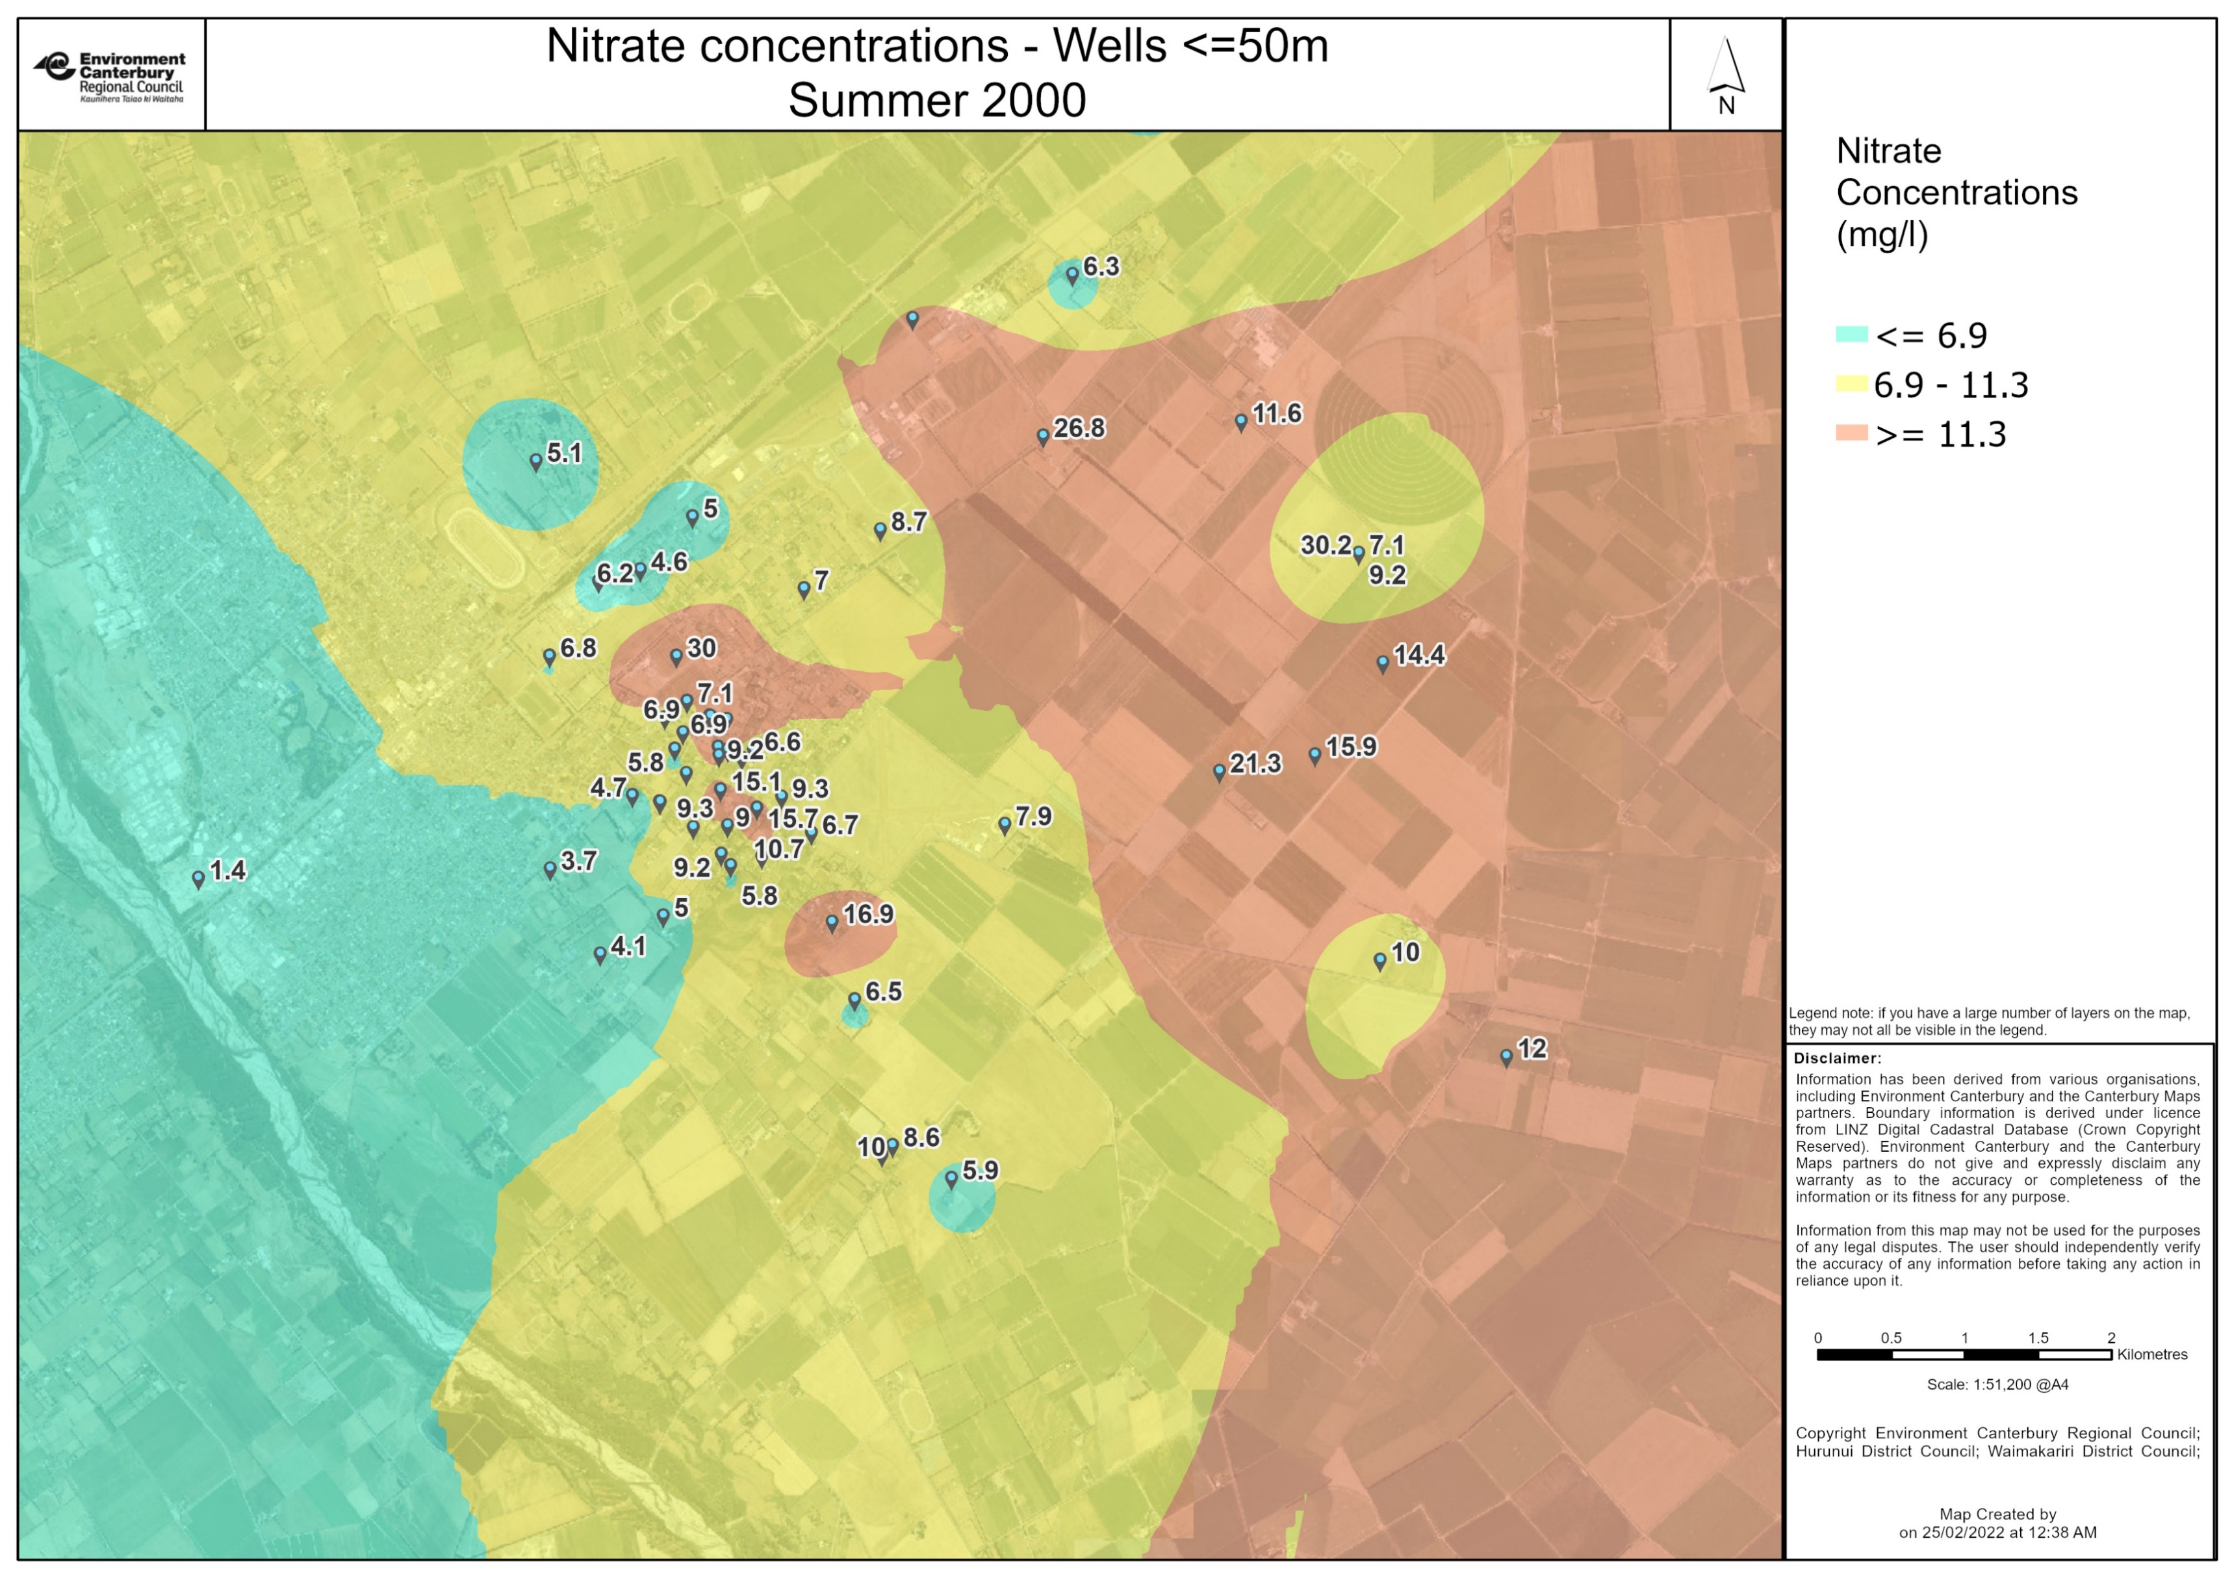
Notes:
CH

Slide 8
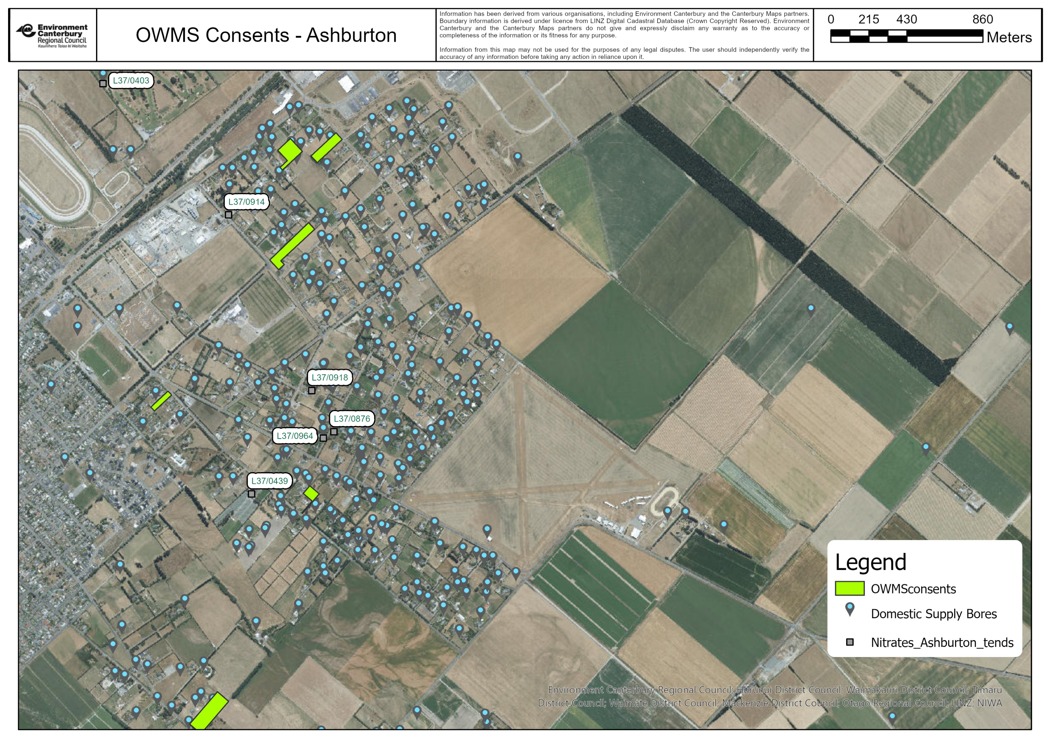
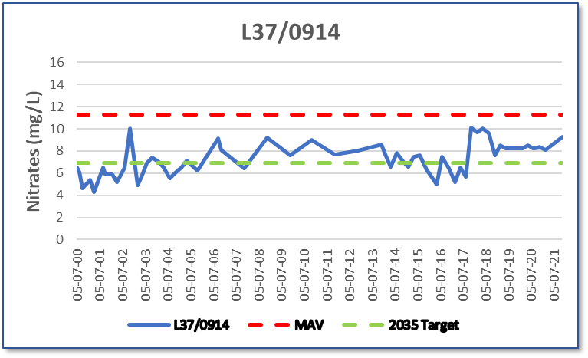
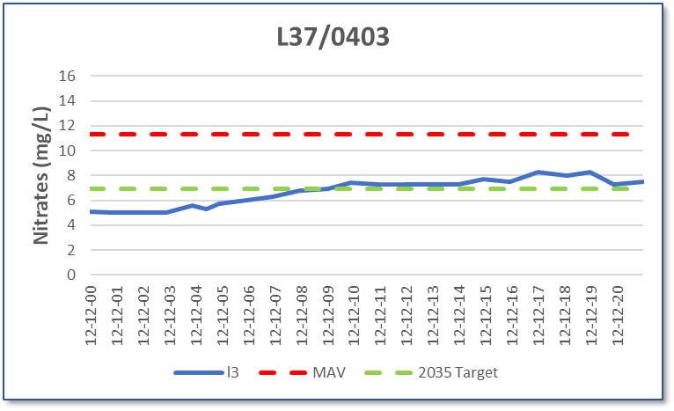
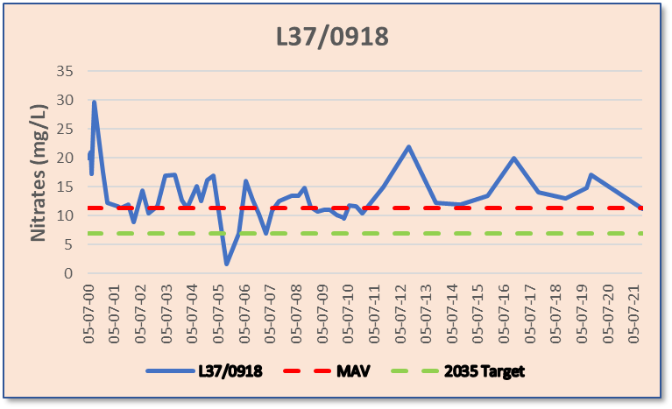
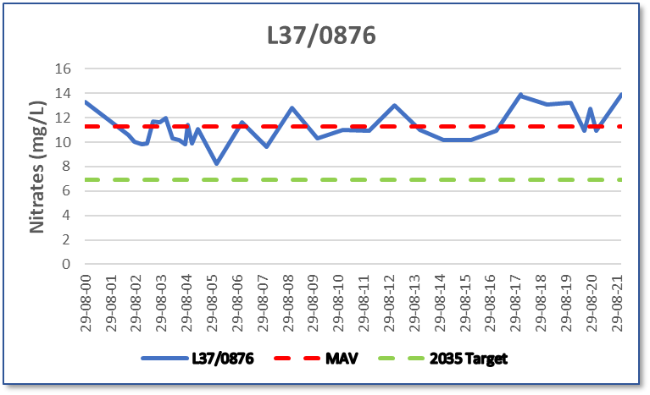
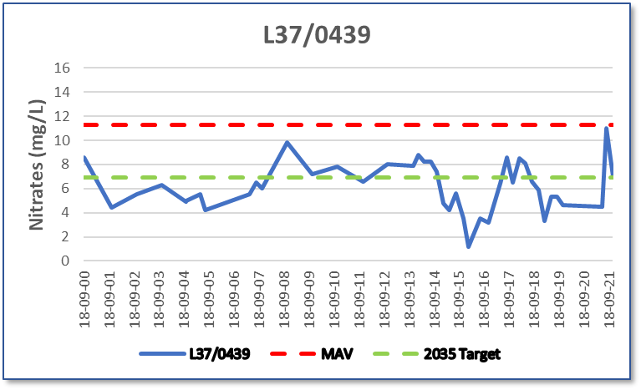
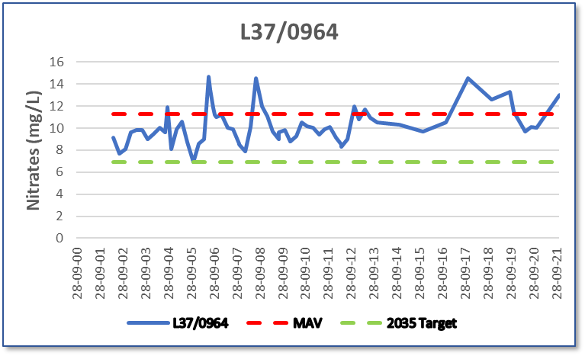
Notes:
CH

Slide 9
There are likely to be increased effects on groundwater where:
Sites are smaller than 4Ha
Properties have no reticulated sewers or water and where groundwater is shallow;
Areas have known high levels of nitrate and E.coli in the groundwater;
Groundwater is shallow and there are properties with drinking-water bores located near or downgradient from the proposed site
Properties are within a Community Drinking-Water Supply Protection Zone.
Notes:
CH

Slide 10
Why this matters
Health risk to water users. Possible contamination of drinking water wells (including homes and larger users) – both E.coli and nitrate;
Impact on tangata whenua values;
National policy means we have to prioritise effect on water body, including groundwater;
Cumulative effects and subdivision intensification increases concern.
Notes:
CS

Slide 11
Where current applications at in the process?
8 applications in total – we know there are further applications pending not yet lodged (mostly for subdivisions)
2 for subdivisions, 6 for individual properties
1 notification decision pending for subdivision
7 on hold or timeframe extension waiting for further information or outcome of notification decision
Further information is required to determine certainty on effects that we are concerned about
Aware of 30 homes this affects in all stages
Notes:
AG

Slide 12
Way forward and options
This is general advice for this area, and not consent-specific.
Permitted activity route
Proceed with seeking consent
Other
Notes:
CS

Slide 13
Permitted activity framework
Certain activities are permitted in the Canterbury Land and Water Regional Plan and may not require resource consent.
Wastewater holding tank – one tank for both grey and black water that has to be regularly emptied.
Split black and grey water system – black water (toilet) holding tank plus greywater treatment and discharge system. Four lot subdivision recently granted code of compliance on this basis adjacent to this area. Reduces pumping costs but still required.
We recognise that both these options require regular emptying and servicing (and ongoing costs).
Notes:
CS

Slide 14
Proceed with seeking consent
Consent applications are being received and processed, but pathway is likely to be expensive, lengthy and outcome uncertain.
For most of these consents there will need to be specialist groundwater advice prior to lodging based on high quality secondary treatment systems. This is technical in nature and would be provided by qualified hydro-geologist. This will incur additional costs.
Even with this additional information it is not guaranteed that any consent will be granted.
The notification process increases application costs significantly and takes time (75 days for a limited-notified application and 150 days for a public notification)
Each application has to be evaluated on its own merits but all must consider cumulative effects.
If consent is gained, conditions would require regular maintenance of system.
This incurs regular costs
Notes:
CS

Slide 15
Other options
Aware of other options available:
Composting: would require a consent if discharged.
Incinerating: Limited suppliers, costly and emerging technology. Would need consideration against rules on air emissions.
Notes:
CS

